Slide 1
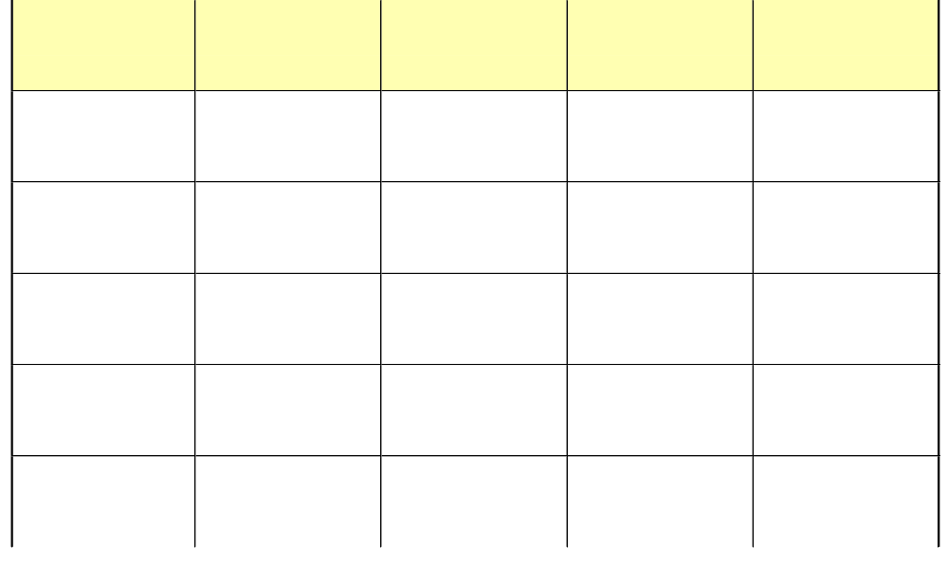
Jeopardy
Word Problems
SOHCAHTOA
45-45-90
Triangles
30-60-90
Triangles
Pythagorean
Theorem
Q $100
Q $100
Q $100
Q $100
Q $100
Q $200
Q $200
Q $200
Q $200
Q $200
Q $300
Q $300
Q $300
Q $300
Q $300
Q $400
Q $400
Q $400
Q $400
Q $400
Q $500
Q $500
Q $500
Q $500
Q $500

Slide 2

$100 Question from Word Problems
A man stands on a bldg and sees his
friend on the ground. If the bldg is
70 m tall and the angle of depression
35 degrees, how many meters is
the man from the building to the
nearest meter?
41º

Slide 3
$100 Answer from Word Problems
100

Slide 4
$200 Question from Word Problems
A man 14 m from a tree notices the
angle of elevation to the top of a
tree is 60 degrees. How many meters
tall is the tree to the nearest tenth?

Slide 5
$200 Answer from Word Problems
24.2 meters

Slide 6
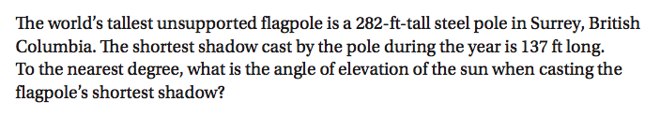
$300 Question from Word Problems
4

Slide 7
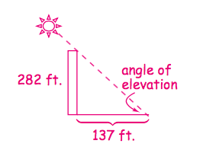
$300 Answer from Word Problems

Slide 8
$400 Question from Word Problems

Slide 9
$400 Answer from Word Problems

Slide 10

$500 Question from Word Problems

Slide 11
$500 Answer from Word Problems

Slide 12
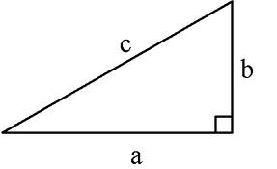
$100 Question from SOHCAHTOA
Using variables, what is the Sin(x)?
xº

Slide 13
$100 Answer from SOHCAHTOA
b
c

Slide 14
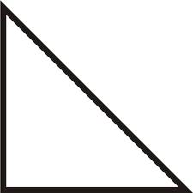
$200 Question from SOHCAHTOA
What is tan(x)?
2√17
8
xº
2

Slide 15
$200 Answer from SOHCAHTOA
4

Slide 16
$300 Question from SOHCAHTOA
What is the Cos(x) in simplest radical form?
xº
√41
5
4

Slide 17
$300 Answer from SOHCAHTOA
5√41
41

Slide 18
$400 Question from SOHCAHTOA
Find the exact measure of the angle x
in the right triangle.
8
4√3
xº
4

Slide 19
$400 Answer from SOHCAHTOA
X = 60º

Slide 20
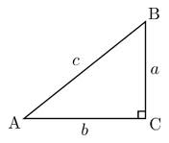
$500 Question from SOHCAHTOA
Fill in all the missing parts of the triangle.
Use simplest radical form and round to the
nearest degree.
A = a =
B = b = 4
C = c = 9

Slide 21
$500 Answer from SOHCAHTOA
A = 64° a = √65
B = 26° b = 4
C = 90° c = 9

Slide 22
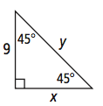
$100 Question from 45-45-90 Triangles
Find x and y in simplest radical form

Slide 23
$100 Answer from 45-45-90 Triangles
x = 9, y =9√2

Slide 24
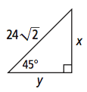
$200 Question from 45-45-90 Triangles
Solve for x and y in simplest radical form

Slide 25
$200 Answer from 45-45-90 Triangles
x=24 and y=24

Slide 26
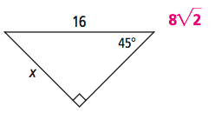
$300 Question from 45-45-90 Triangles
Solve for x in simplest radical form

Slide 27
$300 Answer from 45-45-90 Triangles

Slide 28
$400 Question from 45-45-90 Triangles
Find the hypotenuse in Triangle ABC
in simplest radical form.
AC = 3 m<C = 90 m<A=45

Slide 29
$400 Answer from 45-45-90 Triangles
3√2

Slide 30
$500 Question from 45-45-90 Triangles
Find the length of the leg in Triangle
ABC in terms of x.
m<C = 90 m<B=45 AB=2x

Slide 31
$500 Answer from 45-45-90 Triangles
x√2

Slide 32
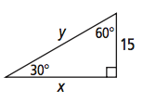
$100 Question from 30-60-90 Triangles
Find x and y in simplest radical form

Slide 33
$100 Answer from 30-60-90 Triangles
y = 30, x =15√3

Slide 34
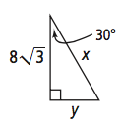
$200 Question from 30-60-90 Triangles
Find x and y in simplest radical form

Slide 35
$200 Answer from 30-60-90 Triangles
y = 8 and x=16

Slide 36
$300 Question from 30-60-90 Triangles
Solve for AB in simplest radical form
m<A = 30^{o BC=4}
m<B = 90º

Slide 37
$300 Answer from 30-60-90 Triangles
AB=4√3

Slide 38
$400 Question from 30-60-90 Triangles
Solve for AC in simplest radical form
m<A = 30^{o AB=62}
m<B = 60º

Slide 39
$400 Answer from 30-60-90 Triangles
AC = 31√3

Slide 40
$500 Question from 30-60-90 Triangles
Solve for AB in simplest radical form
m<A = 60^{o BC=4}
m<B = 90º

Slide 41
$500 Answer from 30-60-90 Triangles
AB = 4√3
3

Slide 42
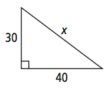
$100 Question from Pythagorean Theorem
Solve for x in simplest radical form

Slide 43
$100 Answer from Pythagorean Theorem
x = 50

Slide 44
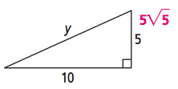
$200 Question from Pythagorean Theorem
Solve for y in simplest radical form

Slide 45
$200 Answer from Pythagorean Theorem

Slide 46

$300 Question from Pythagorean Theorem
Find x in simplest radical form

Slide 47
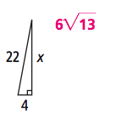
$300 Answer from Pythagorean Theorem

Slide 48

$400 Question from Pythagorean Theorem

Slide 49
$400 Answer from Pythagorean Theorem

Slide 50
$500 Question from Pythagorean Theorem

Slide 51
$500 Answer from Pythagorean Theorem

